Slide 1
UNIT 4 Part A
Cloud Computing Technologies and Applications
Abhishek Bhattacherjee

Slide 2
Table of Content
Cloud Computing Technologies and Applications :
Content Delivery Network (CDN) Services,
Multi-CDN, Features of Meta CDN,
Mobile Cloud Computing (MCC),
InterCloud Issues

Slide 3
Content Delivery Network (CDN) Services in CLoud
A content delivery network (CDN) is a geographically dispersed network of servers and data centers.
The primary goal of a CDN is to improve web performance by reducing the time needed to send content and rich media to users.
CDN architecture is also designed to reduce network latency caused by hauling traffic over long distances and across several networks.
CDN servers are often referred to as "edge servers" since all CDN servers are located on the "edge network" — closer to end-users than a host server from which an application or a website originates.

Slide 4
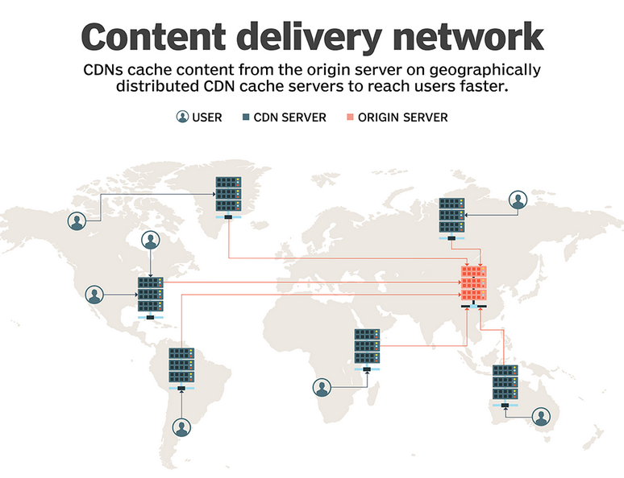

Slide 5
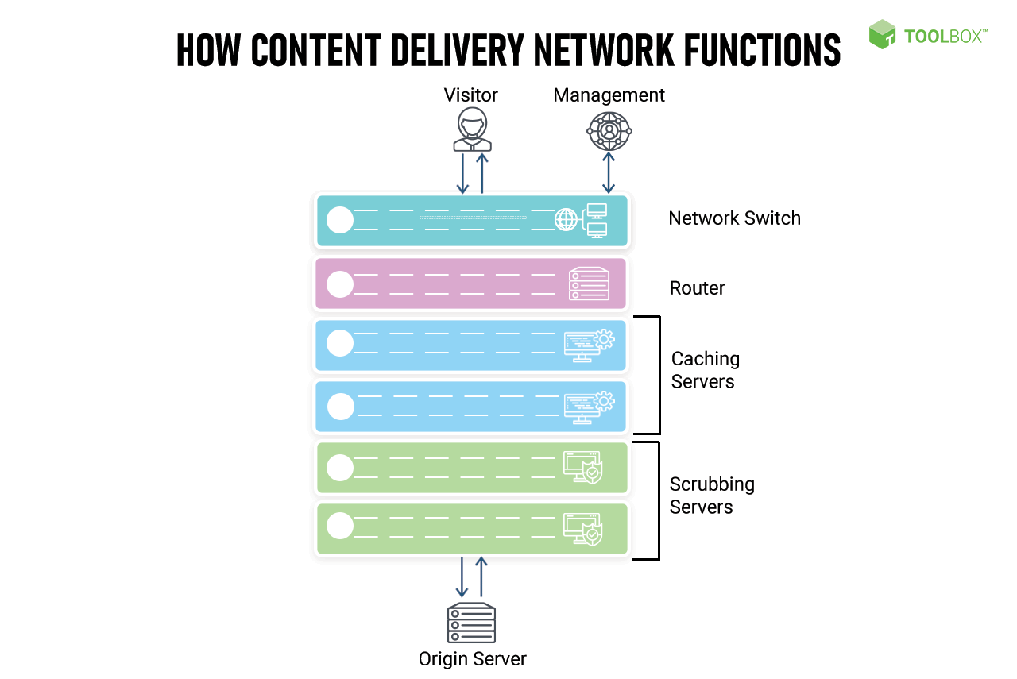
Scrubbing means that you stay online during attacks without losing service. Live traffic is analysed with malicious traffic removed and clean traffic passed on for delivery.

Slide 6
Multi-CDN
A multi-CDN is the combination of multiple CDNs (content delivery networks) from different providers into a single network.
A multi-CDN strategy can help you reduce latency, improve performance and save costs

Slide 7
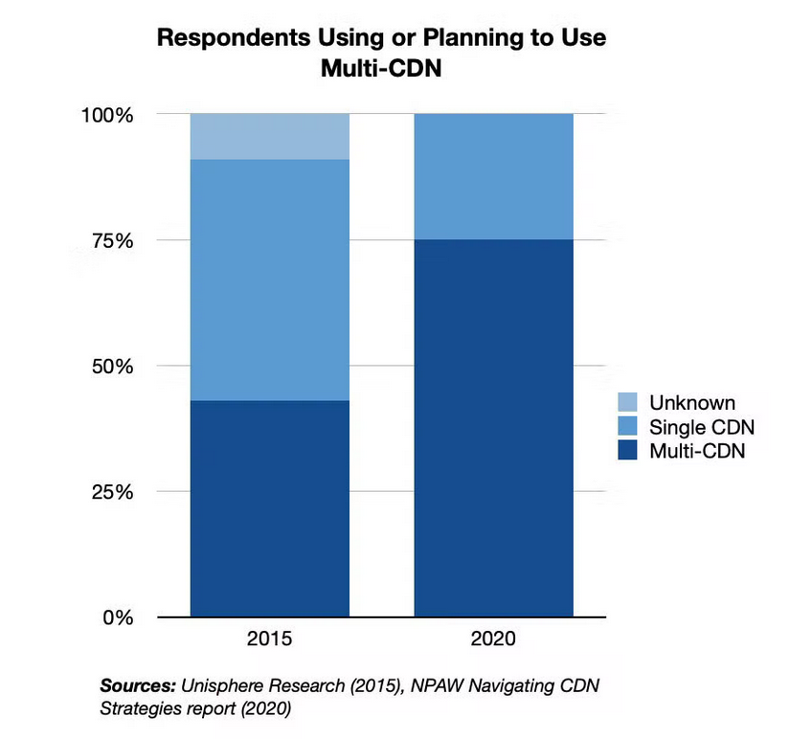

Slide 8
Meta CDN
MetaCDN, a system that exploits ‘Storage Cloud’ resources, creating an integrated overlay network that provides a low cost, high performance CDN for content creators. MetaCDN removes the complexity of dealing with multiple storage providers, by intelligently matching and placing users’ content onto one or many storage providers based on their quality of service, coverage and budget preferences. MetaCDN makes it trivial for content creators and consumers to harness the performance and coverage of numerous ‘Storage Clouds’ by providing a single unified namespace that makes it easy to integrate into origin websites, and is transparent for end-users.

Slide 9
Mobile Cloud Computing (MCC)
Mobile cloud computing (MCC) is the method of using cloud technology to deliver mobile apps.
Complex mobile apps today perform tasks such as authentication, location-aware functions, and providing targeted content and communication for end users.
Examples of MCC
Finance and Commerce: Using your phone or tablet to track your account balance, making a purchase on ecommerce platforms such as Amazon, Shopify, etc., is an example of mobile cloud computing

Slide 10
Types of Cloud-Based Resources in MCC are:
Distant Immobile Cloud Computing
Hybrid Cloud Computing
Proximate Immobile Computing Entities
Proximate Mobile Computing Entities

Slide 11
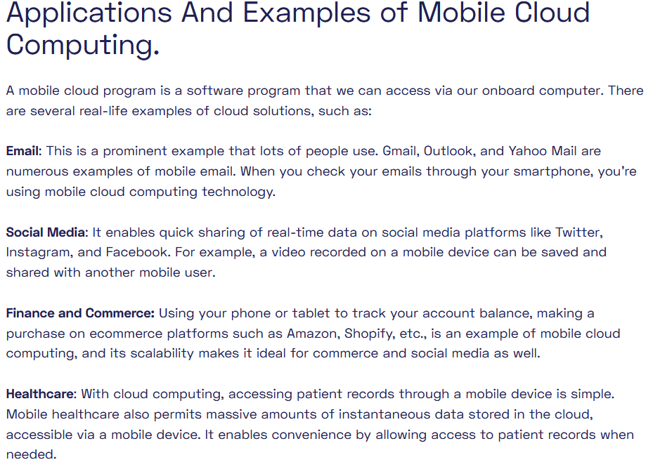

Slide 12
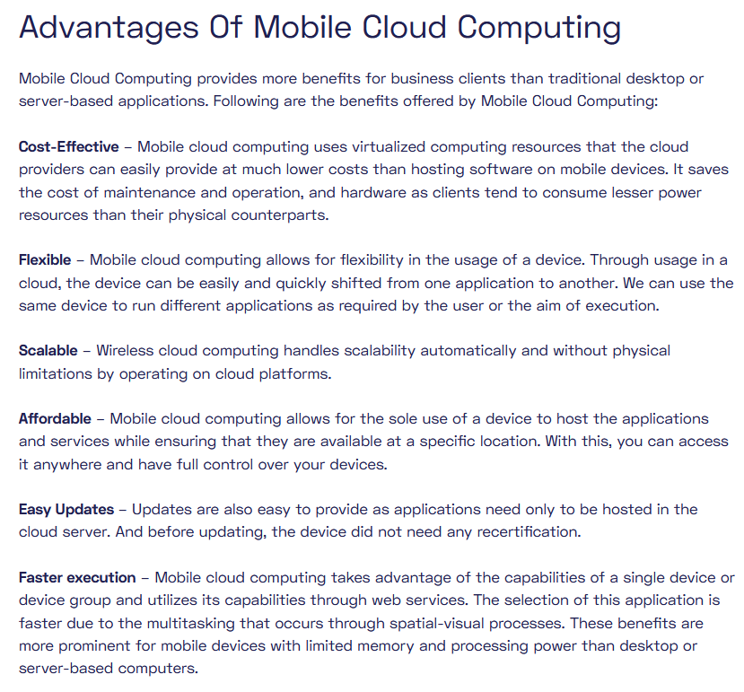

Slide 13
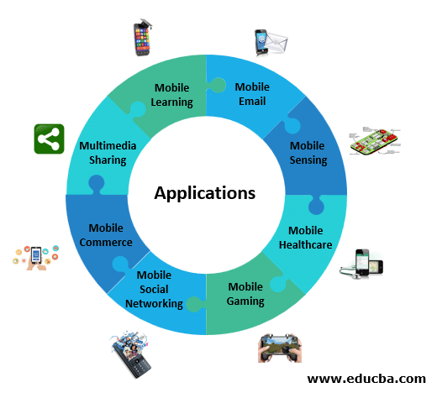

Slide 14
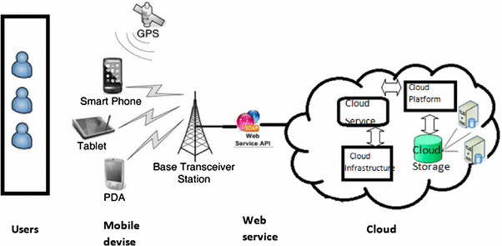

Slide 15
InterCloud Issues
Intercloud or ‘cloud of clouds’ is a common term used for cloud computing.
An intercloud architecture moves data between the infrastructure of multiple cloud service providers (CSPs).
Intercloud systems enable organizations to take complete control of their application on the cloud and use corporate data anywhere, anytime. It offers seamless connectivity and addresses common organizational issues, like security, performance, and flexibility.
The concept of Intercloud was first introduced to the world in 2008 when Cisco- the global leader in IT and networking, started it as a research project.
Later, it was taken over by IEEE (Institute of Electrical and Electronics Engineers) to improve the functionality of existing cloud networks.
Later in early 2009, it gained popularity and was regarded as the data center of the future.

Slide 16
Intercloud is a cloud deployment model that links multiple public cloud services together as one holistic and actively orchestrated architecture.
For example, Amazon, Google, Microsoft, Salesforce.com, and others have established data centers for hosting cloud application services such as social networking, gaming portals, and business applications.

Slide 17
Issues
Lack of interoperability and adopted standards together with intricate regulatory context,
inflexible pricing models and
not adequate SLAs are recognized as the main obstacles to Cloud adoption.

Slide 18
Machine Learning and Cloud Computing
Machine Learning (ML) is a subset of artificial intelligence that emulates human learning, allowing machines to improve their predictive capabilities until they can perform tasks autonomously, without specific programming. ML-driven software applications can predict new outcomes based on historical training data. Training an accurate ML model requires large amounts of data, computing power, and infrastructure. Training a machine learning model in-house is difficult for most organizations, given the time and cost. A cloud ML platform provides the computing, storage, and services required to train machine learning models. Cloud computing makes machine learning more accessible, flexible, and cost-effective while allowing developers to build ML algorithms faster. Depending on the use case, an organization may choose different cloud services to support their ML training projects (GPU as a service) or leverage pre-trained models for their applications (AI as a service). The combination of machine learning and cloud computing has indeed been a game-changer for deploying machine learning models and enhancing their capabilities. Let's explore some of the key ways in which cloud computing benefits machine learning applications:
Scalability: Cloud computing platforms offer virtually unlimited resources that can be easily scaled up or down based on demand. This is especially important for machine learning tasks that require substantial computational power and storage. Data scientists can access resources on demand, efficiently working with large datasets and complex models.
Cost-Efficiency: Cloud computing follows a pay-as-you-go model, where users are billed only for the resources they consume. This eliminates the need for significant upfront investments in hardware and infrastructure. It also ensures that resources are utilized optimally, making machine learning projects more cost-effective.
Data Storage: As you mentioned, machine learning models often require massive amounts of storage to store datasets, models, and other related files. Cloud providers offer various storage solutions like object storage, file storage, and databases that can handle large-scale data storage and retrieval efficiently.
Data Processing: Machine learning algorithms may need considerable computational power to process and analyze vast amounts of data. Cloud computing platforms provide powerful processing capabilities, including GPU and TPU instances, significantly accelerating training and inference tasks.
Collaboration and Accessibility: Cloud-based machine learning projects are easily accessible to teams and collaborators from different locations. This fosters collaboration and allows for seamless sharing of code, data, and models.
Pre-built Services: Major cloud providers offer machine learning-specific services and tools, such as Amazon SageMaker, Google Cloud AI Platform, and Azure Machine Learning. These services abstract away much of the infrastructure management and allow data scientists to focus on building models and experimenting with different algorithms.
AutoML: Cloud-based AutoML (Automated Machine Learning) services enable users to automate the process of building and optimizing machine learning models. These platforms automatically handle various steps, such as data preprocessing, feature engineering, algorithm selection, and hyperparameter tuning, making it easier for non-experts to deploy machine learning solutions.
Real-Time Inference: Cloud computing enables the deployment of machine learning models as APIs (Application Programming Interfaces). This allows real-time inference, where predictions can be obtained rapidly and at scale, making it suitable for fraud detection, recommendation systems, and natural language processing applications.

Slide 19
What is Machine Learning?
Machine Learning is an Artificial Intelligence (AI) application that allows machines to learn and improve from experience automatically. Machine Learning can be classified as follows:
Supervised
Unsupervised
Semi-supervised
Reinforcement
The primary aim of Machine Learning is to provide the capability to computers learn automatically without human intervention or assistance and adjust actions accordingly.

Slide 20
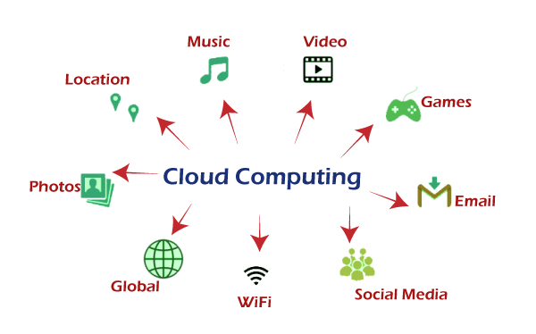
What is Cloud Computing?
Cloud computing is defined as the outsourcing technology of computer software, which enables us to access applications and data remotely. It does not require any software installation and storage in your computer hard drive. Only you have to sign up to enjoy the services online.

Slide 21
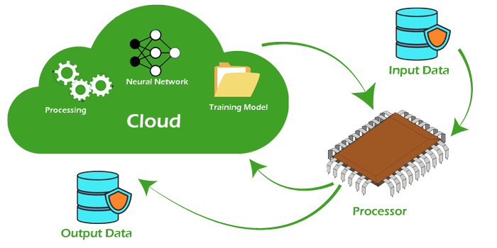
Why Cloud computing in Machine Learning
Although cloud computing and machine learning are emerging technologies, machine learning is comparatively new. Both technologies play important roles in companies' growth, but they become more powerful together. Machine learning makes intelligent machines or software, and on the other hand, cloud computing provides storage and security to access these applications.
The main connection between machine learning and cloud computing is resource demand. Machine learning requires a lot of processing power, data storage, and many servers simultaneously to work on an algorithm. Then Cloud computing plays a significant role in providing new servers with pre-defined data and changing resources over the Cloud (internet). Using cloud computing, you can spin up any number of servers you want, work on the algorithm, then destroy the machines again when complete.
Cloud Computing is primarily used for computation purposes, machine learning needs a lot of computational power to create sample data, and not everyone has access to many strong machines. Machine learning finds (sometimes) task scheduling and storage in cloud computing.

Slide 22
Benefits and Limitations of Machine Learning with Cloud Computing
Benefits:
Scalability: Cloud computing provides the ability to scale machine learning applications to handle large datasets and complex models efficiently. Users can access vast computational resources on demand, allowing them to tackle projects of any size.
Cost-Efficiency: Cloud-based machine learning follows a pay-as-you-go model, eliminating the need for significant upfront investments in hardware and infrastructure. This cost-effective approach allows organizations to manage their resources more efficiently.
Flexibility and Accessibility: Cloud-based machine learning projects are accessible from anywhere with an internet connection, promoting collaboration among teams and facilitating remote work.
Pre-built Services: Major cloud providers offer pre-built machine learning services and tools, such as AutoML, data preprocessing, and model deployment solutions, which accelerate development and reduce the complexity of implementing machine learning algorithms.
Real-Time Inference: Cloud computing enables the deployment of machine learning models as APIs, supporting real-time inference and integration with other applications, making it suitable for real-time decision-making.
Data Storage and Processing: Cloud platforms provide robust data storage and processing capabilities, making it easier to manage large datasets and conduct computationally-intensive tasks like training deep learning models.
Security: Cloud providers invest heavily in security measures and compliance standards, ensuring the protection of sensitive data and reducing the risk of data breaches.
Limitations:
Data Privacy and Compliance Concerns: Storing sensitive data on cloud servers raises data privacy and compliance concerns, particularly in industries with strict regulations, such as healthcare and finance.
Latency: Real-time inference in cloud-based machine learning may suffer from latency issues due to network communication, especially if the data center is far from the end users.
Dependency on Internet Connectivity: Cloud-based machine learning requires a stable Internet connection. In cases of limited or unreliable internet access, this can be a hindrance.
Vendor Lock-in: Adopting a specific cloud provider's machine learning services may result in vendor lock-in, making it difficult to migrate to other platforms in the future.
Cost Overruns: While cloud computing can be cost-effective, unoptimized resource usage can lead to unexpected cost overruns if resources are not managed efficiently.
Limited Control over Infrastructure: Cloud providers manage the underlying infrastructure, which means users have limited control over hardware configurations, software updates, and maintenance.
Data Transfer and Bandwidth Limitations: Uploading large datasets to the cloud and transferring data back and forth can be time-consuming and subject to bandwidth limitations.

Slide 23
Types of cloud-based machine learning services
AutoML (Automated Machine Learning): AutoML services are designed for users with limited machine learning expertise. These platforms automate the end-to-end process of building and optimizing machine learning models, including data preprocessing, feature engineering, algorithm selection, and hyperparameter tuning. Users only need to provide their data and specify the task (e.g., classification or regression), and the service handles the rest.
Model Training and Deployment Platforms: These services offer infrastructure and tools for training machine learning models at scale. Data scientists can use these platforms to upload their datasets, experiment with various algorithms and hyperparameters, and then deploy the trained models as APIs for real-time inference.
Machine Learning APIs: Cloud providers offer APIs that allow developers to integrate pre-trained machine learning models into their applications. These APIs cover various tasks like image and speech recognition, natural language processing (NLP), sentiment analysis, and more. Developers can access advanced machine learning capabilities without having to build and train models from scratch.
Data Preprocessing Services: Cloud-based data preprocessing services help clean, transform, and prepare datasets before they are used for training machine learning models. These services often include functionalities like data cleaning, feature scaling, and handling missing values.
Big Data and Data Analytics Services: Some cloud platforms provide services for big data processing and analytics. These services can be leveraged to perform large-scale data analysis, extract insights, and support machine learning workflows with massive datasets.
Hyperparameter Optimization: Cloud-based hyperparameter optimization services automatically tune the hyperparameters of machine learning models to find the optimal configuration for a given task. This saves time and effort in manually tweaking hyperparameters.
Reinforcement Learning Platforms: Cloud-based reinforcement learning services provide environments and tools for developing and training reinforcement learning agents. These services are useful for building AI systems that learn from interaction with their environment.
Edge AI Services: Some cloud providers offer edge AI services that enable the deployment of machine learning models directly on edge devices, such as IoT devices or smartphones. This allows for real-time inference on the edge without relying solely on cloud connectivity.
Machine Learning Notebooks: Cloud-based machine learning notebooks provide a collaborative and interactive environment for data scientists to experiment, write code, visualize data, and build machine learning models. These notebooks often support popular programming languages like Python and R.

Slide 24
AIaaS
"Artificial Intelligence as a Service." It refers to cloud-based platforms and services that provide artificial intelligence (AI) capabilities and tools to developers, data scientists, and businesses. AIaaS allows users to access and utilize advanced AI technologies without the need to build and maintain the underlying infrastructure themselves. Instead, they can leverage pre-built AI models, algorithms, and tools offered by the cloud provider.
Some of the key features and benefits of AIaaS include:
Pre-built AI Models: AIaaS platforms offer a variety of pre-trained AI models for tasks like image and speech recognition, natural language processing (NLP), sentiment analysis, translation, and more. Users can integrate these models into their applications without the need for extensive AI expertise.
AutoML Services: AIaaS often includes AutoML functionality, enabling users to build custom machine learning models without manual coding or tuning. These services automate the model building process, making it more accessible to non-experts.
Scalability: AIaaS platforms are designed to handle large-scale AI workloads, ensuring that applications can handle increased usage and demand.
Cost-Efficiency: AIaaS follows a pay-as-you-go model, where users are charged based on their AI usage. This eliminates the need for upfront investments in hardware and software, making it cost-effective for businesses of all sizes.
Flexibility: Users can choose from a range of AI services based on their specific needs, without being locked into a single AI framework or technology.
Real-Time Inference: AIaaS enables real-time inference through APIs, allowing applications to make AI-driven decisions in real-time.
Integration with Other Cloud Services: AIaaS can be seamlessly integrated with other cloud-based services, such as data storage, data analytics, and IoT, to build comprehensive AI-driven applications.
Developer-Friendly: AIaaS platforms often provide developer-friendly APIs and SDKs, making it easier to integrate AI capabilities into applications and services.
Examples of AIaaS offerings from major cloud providers include:
Amazon AI services (Amazon SageMaker, Rekognition, Polly, Lex, etc.) on Amazon Web Services (AWS).
Google Cloud AI Platform (Cloud Vision API, Cloud Natural Language API, etc.) on Google Cloud.
Azure Cognitive Services (Computer Vision, Speech-to-Text, Text Analytics, etc.) on Microsoft Azure.

Slide 25
GPUaaS
The growing adoption of machine learning and AI across various industries has increased the demand for robust computing resources. This need for high-performance hardware has given rise to GPU-as-a-Service (GaaS), a cloud-based solution that offers on-demand access to GPUs. By utilizing the power of graphics processing units (GPUs), GaaS allows users to leverage advanced computational capabilities without the need for expensive hardware or complex infrastructure management.
Key benefits of using GaaS include:
Scalability: Users can effortlessly adjust GPU resources based on project requirements.
Elasticity: The pay-per-use model enables organizations to pay only for what they use, reducing overall expenses.
Data security: Cloud providers typically employ robust security measures to ensure the protection of sensitive information.
Faster time-to-market: GaaS allows for rapid prototyping and deployment by granting immediate access to cutting-edge technology.
GaaS is suitable for various applications, such as:
Machine learning and deep learning: GPUs can significantly accelerate the training of complex models on large datasets, enabling data scientists to iterate more quickly and improve model accuracy.
Data processing and analytics: Many big data processing tasks, like sorting or filtering, can benefit from parallel computing capabilities offered by GPUs, allowing organizations to process vast amounts of data more efficiently.
High-performance computing (HPC): Scientific simulations, financial modeling, and other computationally intensive workloads can utilize GPU acceleration to decrease time-to-solution.
Gaming and virtual reality: Cloud-based gaming services often depend on powerful GPUs for high-quality, real-time graphics rendering, providing an immersive experience.

Slide 26
What is the primary purpose of a Content Delivery Network (CDN)?
Hosting websites
Accelerating content delivery
Managing domain names
Providing cloud storage

Slide 27
2. Which of the following is not a common component of a CDN?
Origin server
Edge servers
Database servers
Content distribution nodes

Slide 28
3. How does a CDN improve website performance?
By increasing the website's security
By reducing latency and increasing content availability
By optimizing database queries
By providing faster internet connections to users

Slide 29
4. Which protocol is commonly used for delivering content through CDNs?
HTTP
FTP
SSH
SMTP

Slide 30
5. What is the term for the process of storing copies of website content on multiple servers around the world to reduce latency?
Caching
Mirroring
Clustering
Replicating

Slide 31
6. Which of the following is not a benefit of using a CDN?
Improved website load times
DDoS protection
Enhanced website security
Decreased server storage costs

Slide 32
7. Which type of CDN server is located closest to the end user and serves cached content?
Origin server
Edge server
Database server
Application server

Slide 33
8. Which HTTP status code is often returned when a CDN successfully delivers cached content?
200 OK
404 Not Found
500 Internal Server Error
301 Moved Permanently

Slide 34
9. True or False: CDNs are primarily used for static content delivery and cannot accelerate dynamic content.

Slide 35
10. What is the process of temporarily storing frequently accessed data closer to the user to reduce the need for repeated requests to the origin server called?
Content replication
Content distribution
Content caching
Content migration

Slide 36
Answers:
B) Accelerating content delivery
C) Database servers
B) By reducing latency and increasing content availability
A) HTTP
A) Caching
D) Decreased server storage costs
B) Edge server
A) 200 OK
9. False (CDNs can accelerate dynamic content as well)
10. C) Content caching

Slide 37
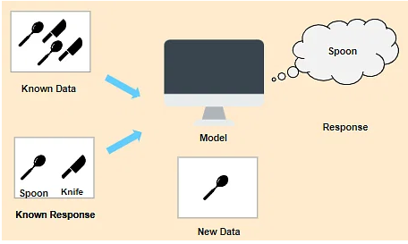
In Supervised Learning, the machine learns under supervision. It contains a model that is able to predict with the help of a labeled dataset. A labeled dataset is one where you already know the target answer.
In this case, we have images that are labeled a spoon or a knife. This known data is fed to the machine, which analyzes and learns the association of these images based on its features such as shape, size, sharpness, etc. Now when a new image is fed to the machine without any label, the machine is able to predict accurately that it is a spoon with the help of the past data.

Slide 38
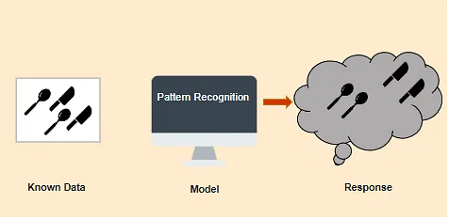
In Unsupervised Learning, the machine uses unlabeled data and learns on itself without any supervision. The machine tries to find a pattern in the unlabeled data and gives a response.
Let's take a similar example is before, but this time we do not tell the machine whether it's a spoon or a knife. The machine identifies patterns from the given set and groups them based on their patterns, similarities, etc.

Slide 39
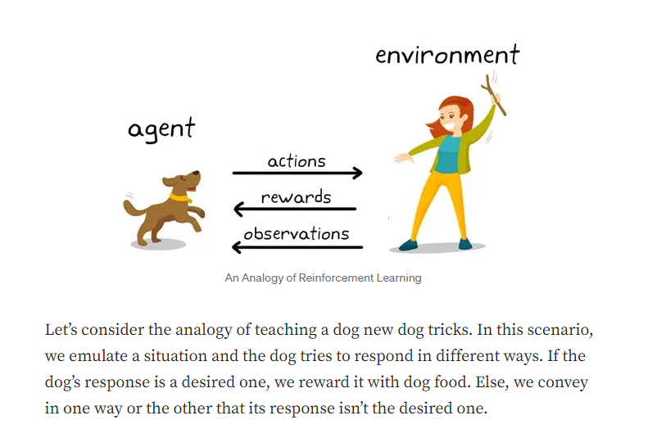
A Reinforcement Learning (RL) task is about training an agent that interacts with its environment. The agent transitions between different scenarios of the environment, referred to as states, by performing actions. Actions, in return, yield rewards, which could be positive, negative or zero.

